Slide 1
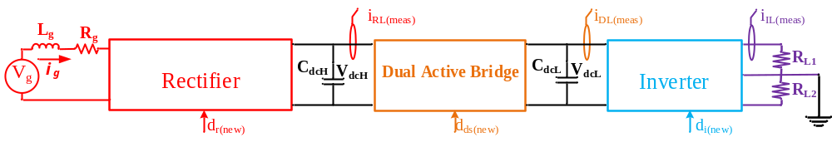
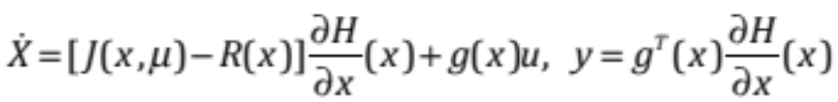
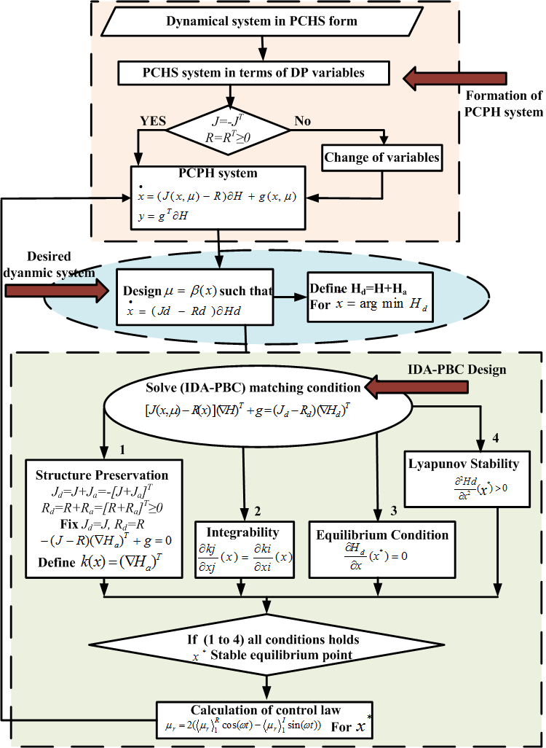
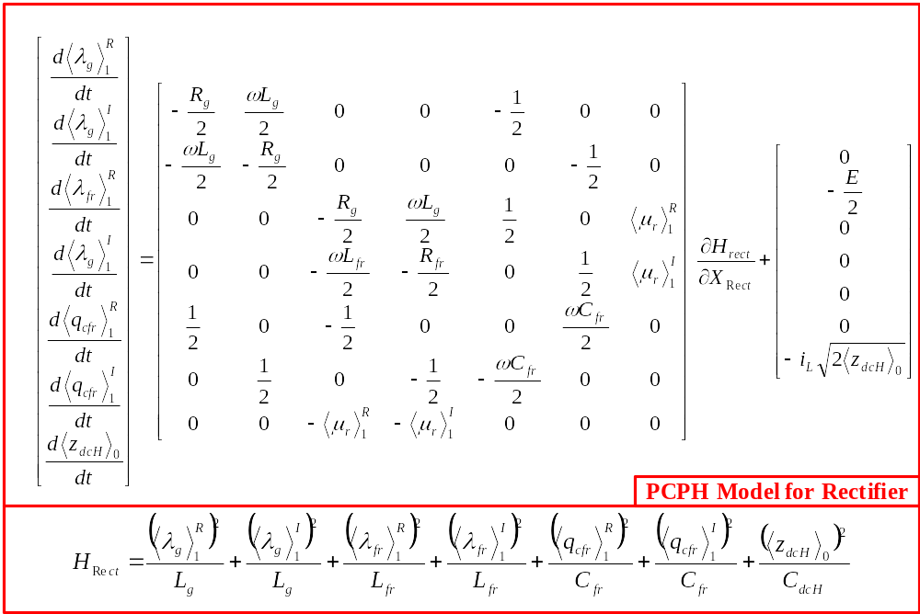
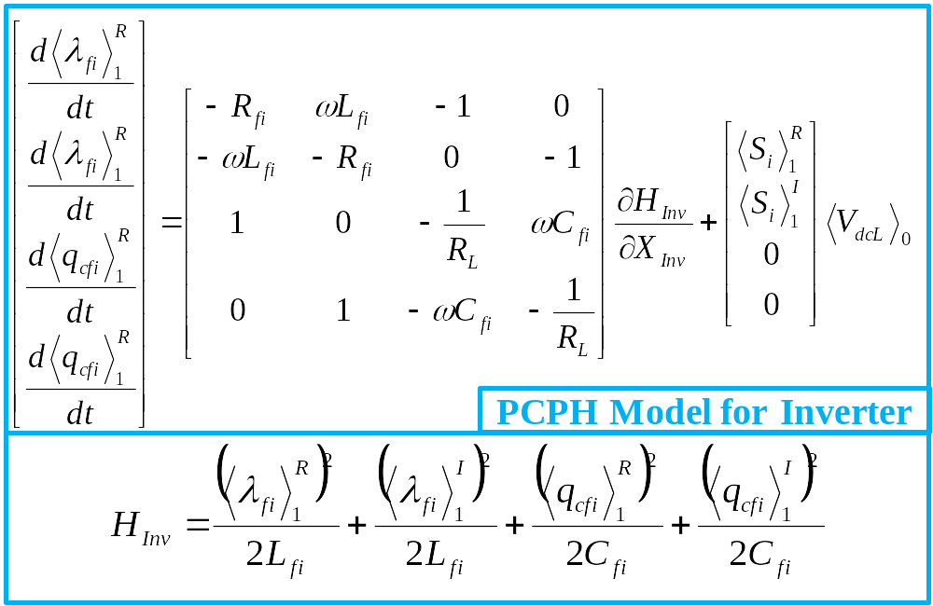
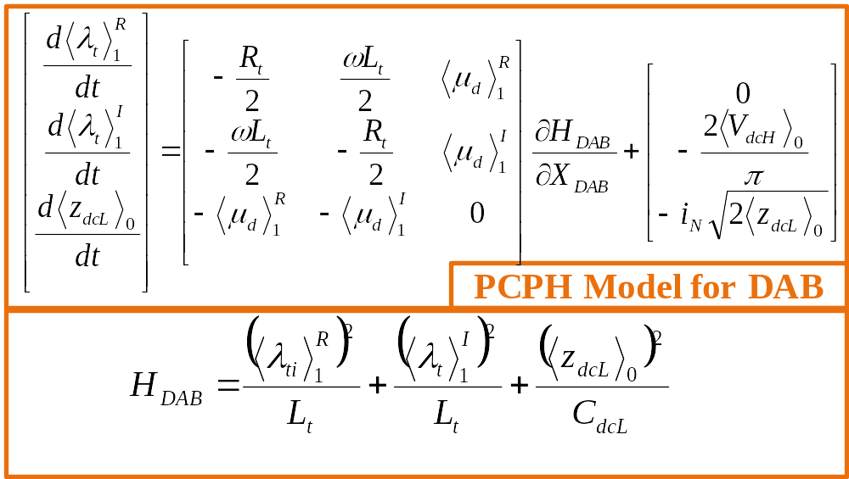
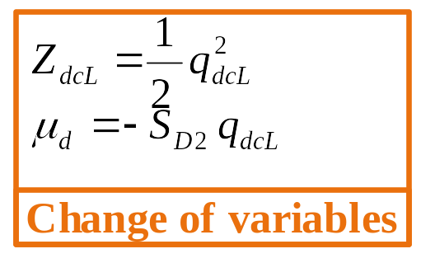
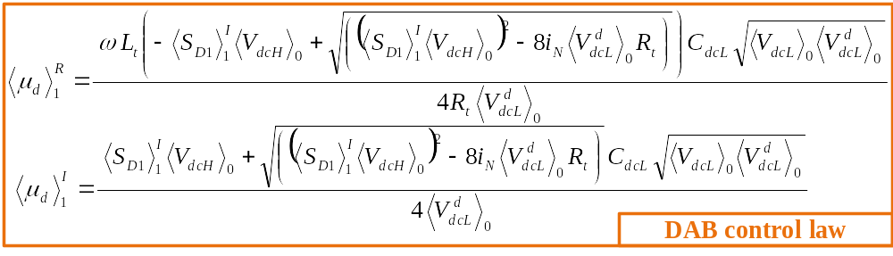
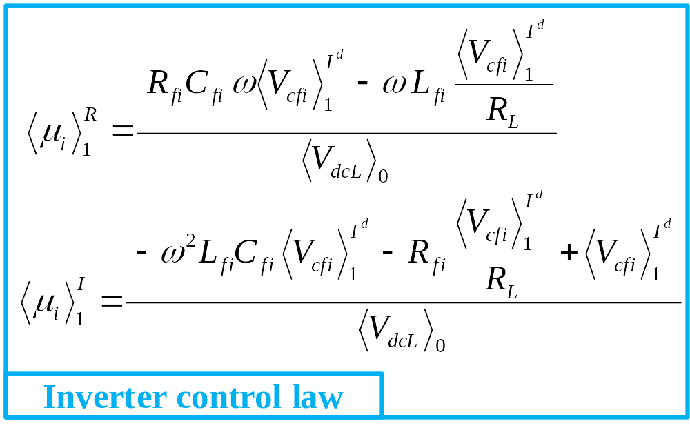
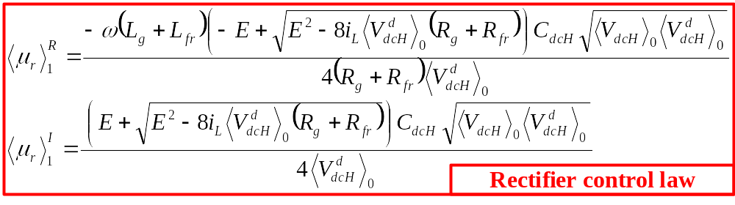

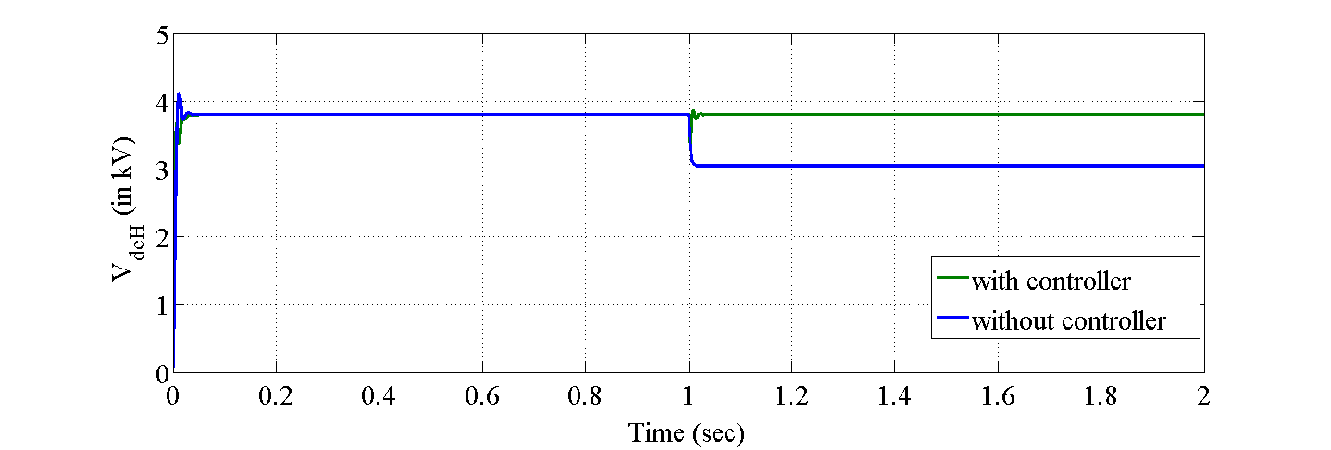
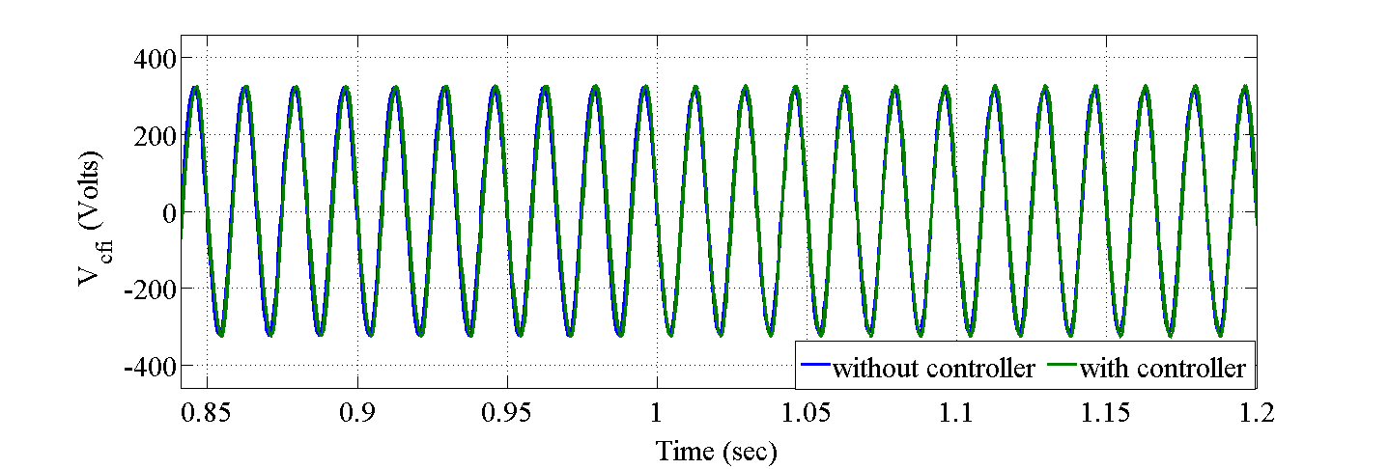
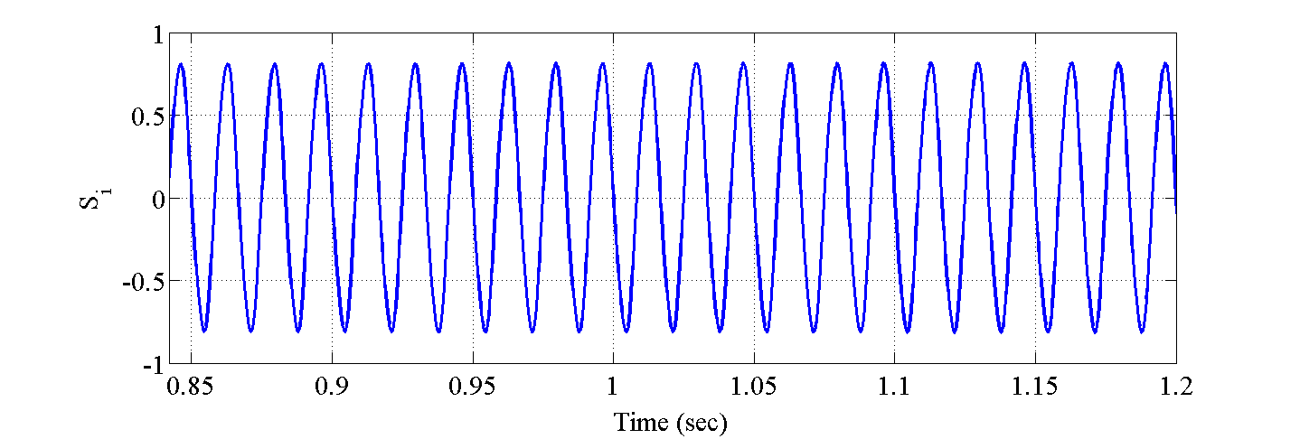
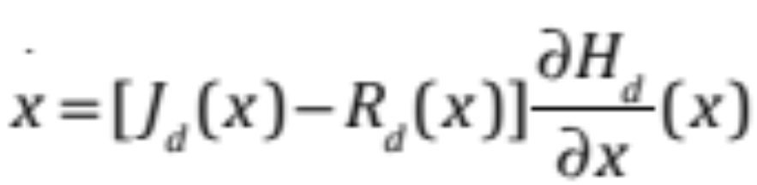
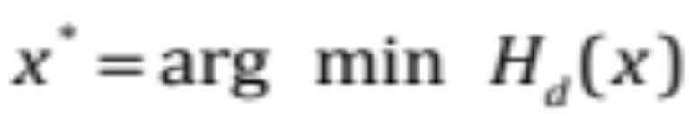
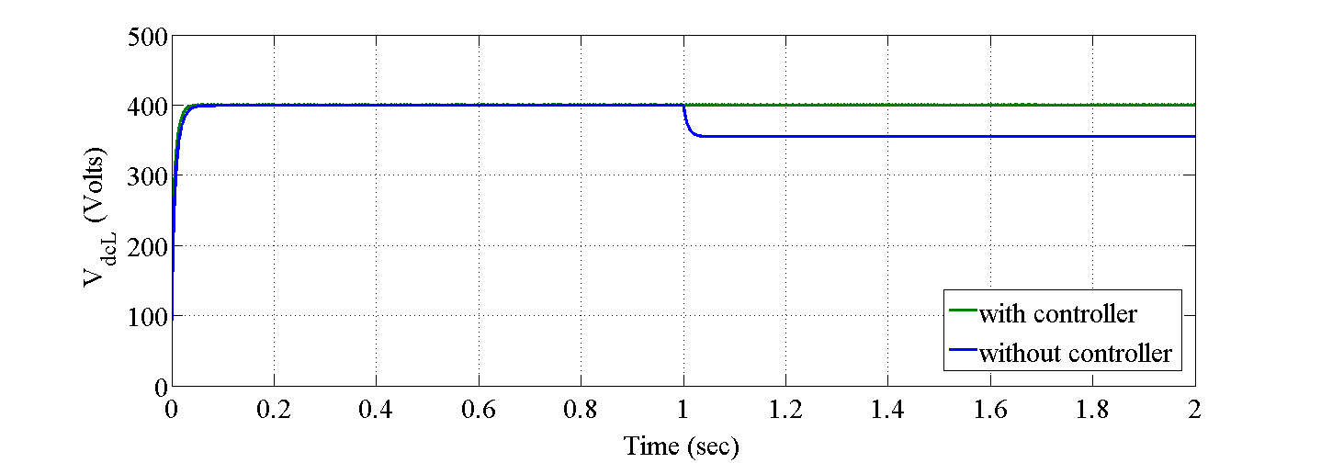
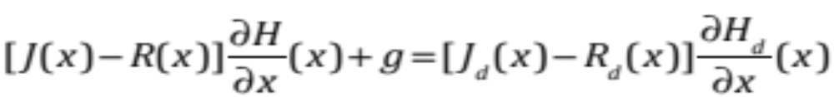
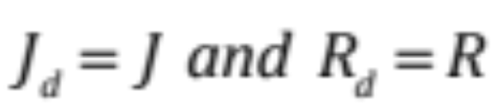
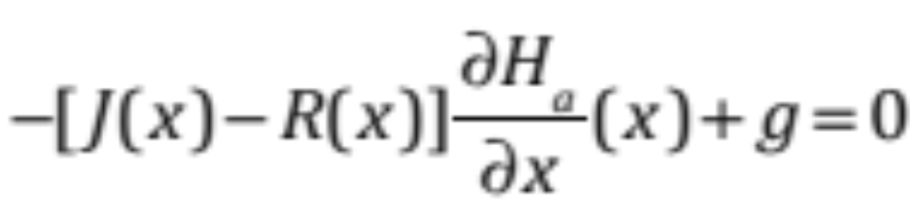
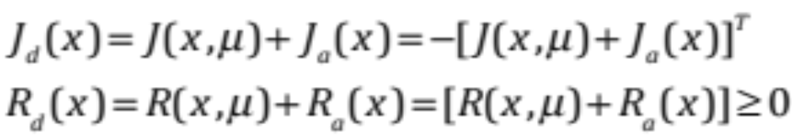
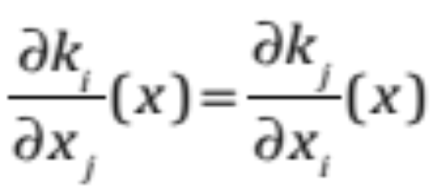
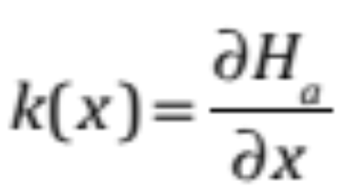
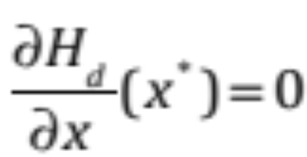
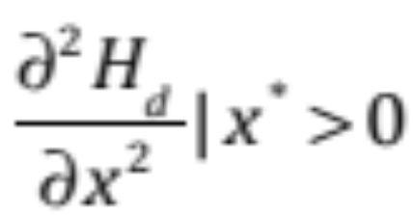
Y8.FS2.6: IDA-PBC Control for Port-controlled Phasor Hamiltonian Model of Solid State Transformer
R. Meshram, S. Khade, M. Monika, N. Singh
S. Wagh and A. Stankovic Tufts University
Objective:
IDA-PBC for Port-controlled Phasor Hamiltonian (PCPH) Model of SST
Contributions
Rectifier output HVDC link voltage (V_{dcH}) regulated to desired constant value and system performance fulfills unity power factor AC mains
Dual Active Bridge output LVDC link voltage (V_{dcL}) regulated to desired constant values
Inverter output voltage (V_{cfi}) track reference output voltage
Features
It is a nonlinear approach and global stability can be assured under input and load uncertainty
Interconnection and Damping Assignment Passivity Based Control (IDA-PBC) scheme for PCPH
Dynamic performance and robustness against input parameter variation and load variation are studied by simulations
System modeled in DP variables
Modular control technique
Stabilization using Energy balance
Technical Approach:
Port-controlled Phasor Hamiltonian Modeling of SST
Where, x-energy variables; μ-duty ratio function
u-input to system ; J-interconnection matrix
R-Damping matrix ; H-Hamiltonian function
g-port feature of system
PCPH is a port-controlled Hamiltonian structure of nonlinear dynamic phasor
model of system
Matching of original open loop PCPH to the desired dynamics
Integration of systems from different domain using energy as
a concept
Closed loop system is energy preserving
Accomplishments:
Validation with simulation results
Fig. 5 Flowchart of IDA-PBC algorithm
Procedure steps for PCPH development and IDA_PBC
Step 1 – Decide desired closed loop system dynamics
Fig. 6 Rectifier output voltage (VdcH) response with load resistance alters from 100 Ω to 80 Ω at 1 sec
Fig. 8 Inverter output voltage (Vcfi) response with load resistance alters from 35 Ω to 30 Ω at 1 sec
Fig. 9 Control output (Si) of Inverter with change in load resistance from 35 Ω to 30 Ω at 1 sec
Step 2 – Find equilibrium point by imposing
Step 3 – Matching Objective
AC supply of 7200 V rms is given through filter to the switching of rectifier and output of HVDC link is observed in Fig. 6 as with load changes system is regulated at desired constant voltage of 3800 V by adjusting duty ratio (S_{r}) accordingly
HVDC link voltage is feed to the DAB with first bridge having constant duty ratio and control of switching over second bridge. In Fig. 7 it is observed that by adjusting duty ratio (S_{D2}) system is regulated at desired constant voltage of 400 V at LVDC link
LVDC link voltage is fed to inverter switching and output is given to filter, Fig. 8 shows filtered output regulated at 230 V rms and adjusted duty ration (S_{i}) is shown in Fig. 9
Step 4 – For convenience, Define
Fixing
Fig. 7 DAB output voltage (VdcL) response with load
resistance alters from 38 Ω to 30 Ω at 1 sec
Step 5 – Structure Preservation
Next Steps:
Modification in controller design to supports bidirectional power flow
Integration of renewable sources to grid using SST in port-controlled phasor Hamiltonian structure and controller design
Step 6 – Integrability
Define
Step 7 – Equilibrium condition
Potential Impact:
Step 8 – Lyapunov stability
Complement:
Time-domain simulations by offering sensitivities to design quantities and basis for control design
Robust control design methods by exploiting simplicity of energy flow and dissipation as a basis for effective design
Port-controlled Hamiltonian descriptions with hierarchical, multi-scale modeling at different levels of abstraction.
 | Input to system | Desired output | Output of system without controller with uncertainty at 1 sec | Actual output with IDA-PBC controller with uncertainty at 1 sec | Settling time
Rectifier | 7200 V rms | 3800 V DC | 3040 V DC | 3800 V DC | 35 msec
DAB | 3800 V DC | 400 V DC | 355 V DC | 400 V DC | 20 msec
Inverter | 400 V DC | 230 V rms | 205 V rms | 230 V rms | 55 msec

